Slide 1
Theory Validation
Dirk Riehle, Univ. Erlangen
NYT D01
Licensed under CC BY 4.0 International

Slide 2
Agenda
Theory validation
Validation strategy
Construct design
Research hypotheses
Example methods
Quality assurance

Slide 3
1. Theory Validation

Slide 4
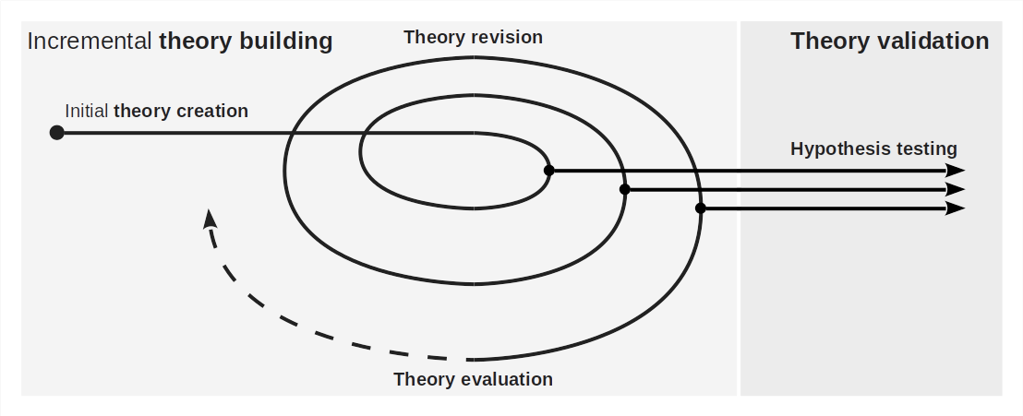
The Process of Science (Recap)

Slide 5
Theory Validation
Theory validation is
The testing of a theory to confirm or punch holes into it
Theory validation should follow a strategy
The primitives of theory validation are hypothesis tests

Slide 6
Purpose of Theory Validation
The purpose of theory validation is to
Discriminately and adversarially test a theory
To identify weaknesses and holes
In a cost-efficient way

Slide 7
The Theory Validation Process
The theory validation research process
Incremental (one hypothesis at a time)
Is never finished
The hypothesis testing process
Is often a one-shot process

Slide 8
What Can Be Learned?
Validation(ism) (verificationism)
The belief that you can proof (“validate”) a theory
Closely aligned with classic positivist stance
Falsification(ism)
The belief that you can't proof a theory correct
But that you should keep it around until it got falsified
Falsification dominates, yet a falsification may be incorrect

Slide 9
2. Validation Strategy

Slide 10
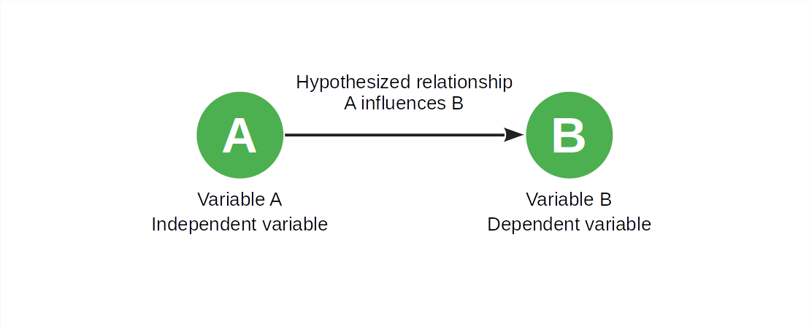
The Minimal Theory (Recap)

Slide 11
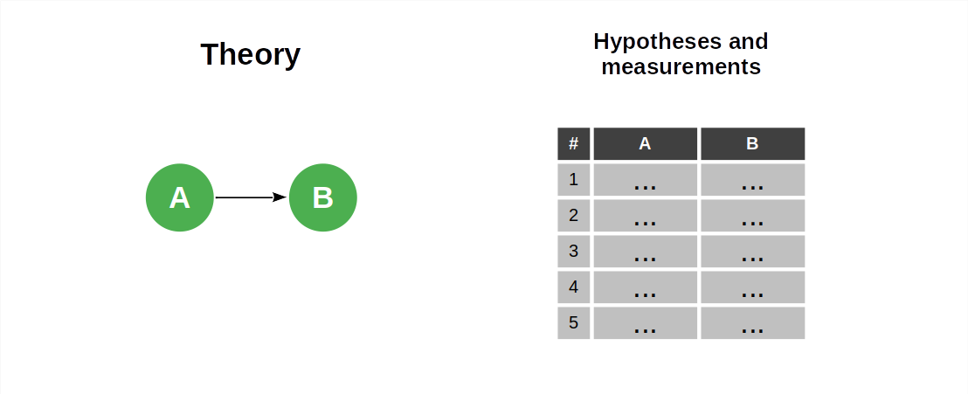
The Minimal Validation Strategy

Slide 12
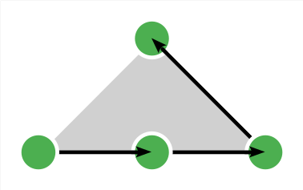
Hypothesis Generation
Hypothesis generation = theory instantiation = deductive reasoning

Slide 13
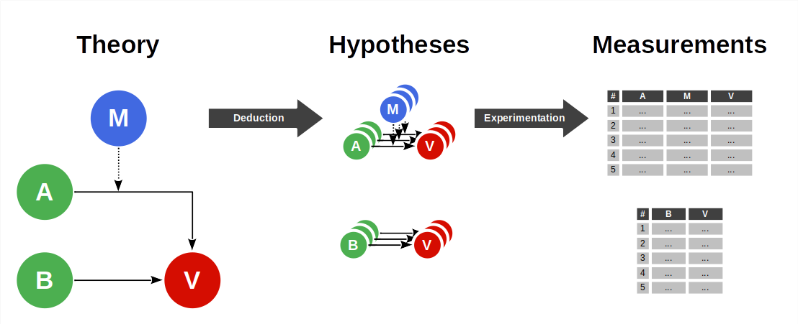
Triangulation in Theory Validation

Slide 14
Theory Validation vs. Application
Use (application) of a theory is a form of hypothesis generation
In theory validation, we
Adversarially seek out boundary cases to test the theory
In theory application, we
Make sure we stay within the sweet spot to build something of use
Pushing application to the edge of theory is usually not a good idea [1]
[1] Cf. the Gallopping Gertie

Slide 15
Quantitative Research Methods
A quantitative research method
Gathers quantitative data
Using sampling methods that allow for statistical generalization
To run a hypothesis test

Slide 16
3. Construct Design

Slide 17
Variables and Constructs
A variable is a
Directly observable one-dimensional phenomenon
A physical variable is a variable that
Reflects a physical reality
A construct is a
Not-directly-observable “latent” phenomenon
Constructs can be multi-dimensional

Slide 18
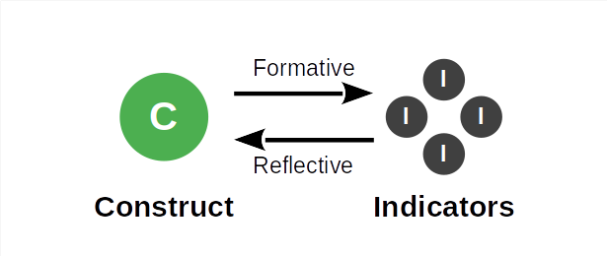
Reflective vs. Formative Constructs [1]
A reflective construct is a construct that
Can be assessed (measured) through appropriate indicators
Reflects some underlying reality
A formative construct is a construct that
Is defined by its measurements
Is entirely created by humans
[1] See Petter et al. (2007): Specifying formative constructs.

Slide 19
Constructs and Indicators
Construct | Indicator 1 | Indicator 2 | Indicator 3
Temperature | Brownian motion
Exam stress level | Heart rate | Amount of sweat
Usability of a website | Clarity | Relevance | Accessibility
Ability to write bug-free code | Number of bugs by difficulty per unit of time
Intention to share access | Open mindedness | Collaborativeness | Goal orientation

Slide 20
Construct Operationalization
Intrinsic definition (reflective constructs)
The definition is based the construct’s assumed intrinsic properties
Then, there can be different ways of measuring the construct
Extrinsic definition (formative constructs)
The construct’s operationalization is its definition
Then, there is is exactly one way of measuring the construct

Slide 21
Construct Validity
Construct validity is
The extent to which an operationalization matches the construct’s definition
Questions to ask
Are any individual indicators measured correctly?
Are the indicators correctly aggregated?
Is the construct domain fully covered?

Slide 22
Measurement Instruments
Physical variables
Corresponding physical devices e.g. a thermometer
Atomic constructs
Human-made instruments e.g. item (question) blocks
Composite constructs
Composites of measurement instruments

Slide 23
Development of Measurement Instruments
Measurement instruments need to be
Invented
Standardized, and
Consistently calibrated
The correspondence of indicators and constructs is its own hypothesis
So is that a measurement instrument correctly reflects this correspondence

Slide 24
4. Research Hypotheses

Slide 25
Research Hypothesis (Recap)
A research question is
The question of interest to be answered by research
A research hypothesis is
A research question that can only be answered with yes or no, true or false
Research questions should answerable and non-trivial
The answer can be big (a whole theory) or small (yes/no)

Slide 26
Hypothesis Testing (Recap)

Slide 27
Correlation and Causation
Variable A correlates with variable B if
Changes to variable A correspond to defined changes in variable B
Variable A causes variable B to change if
Changes to variable A cause defined changes in variable B
Correlation can be measured, causation needs to be established

Slide 28
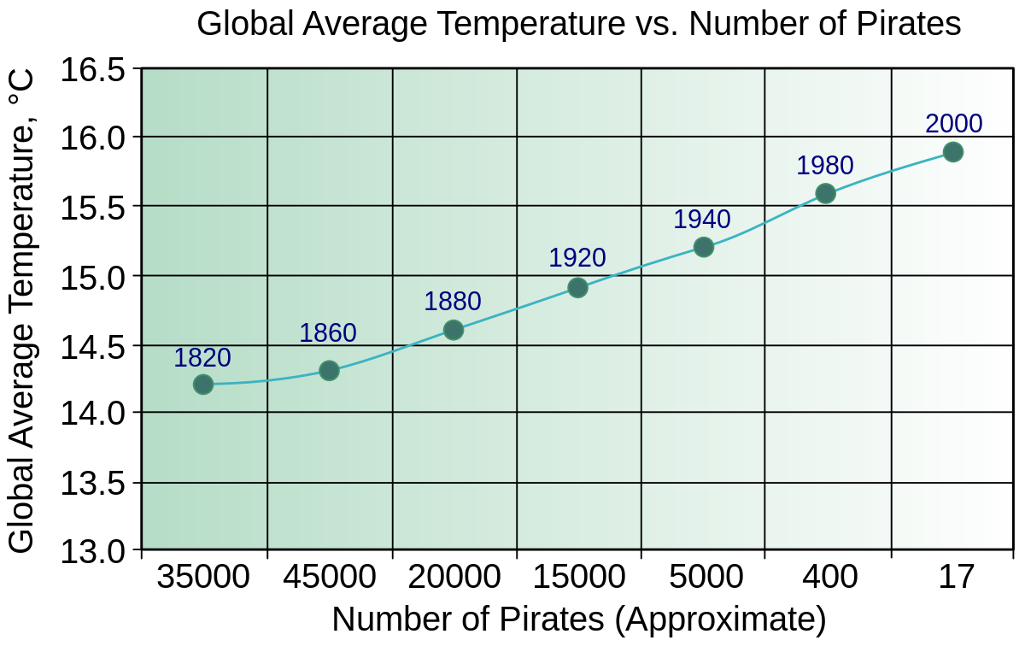
Causation vs. Correlation [1]
[1] See https://commons.wikimedia.org/wiki/File:PiratesVsTemp(en).svg

Slide 29
5. Example Methods

Slide 30
Quantitative Research Methods
Common quantitative research methods
Hypothesis-testing surveys
Controlled experiments
But many other forms of experiments

Slide 31
Hypothesis-Testing Surveys
A hypothesis-testing survey is
A collection of hypothesis tests
Typically with a large sample size
Using item blocks as instruments
Usually presented as a questionnaire
There are other types of surveys, most notably, descriptive surveys
These are not useful for theory validation
They may be useful in theory building

Slide 32
Item Blocks in Hypothesis-Testing Surveys
An item block is
A measurement instrument of a construct
It typically takes the form of set of questions that
Triangulate a measure for the underlying construct
Example item block for personal innovativeness [1]
If I heard about a new technology, I would look for ways to experiment with it
Among my peers, I’m usually the first to try out new technologies
In general, I am hesitant to try out new technologies
I like to experiment with new technologies
[1] See Agarwal & Prasad (1998): Personal innovativeness.

Slide 33
Controlled Experiments
A controlled experiment is
A collection of hypothesis tests where
A treatment is applied to the independent variable to
Measure the effect on the assumed dependent variable
In a tightly controlled environment to isolate the variables of interest
Recipients are typically split into a
Treatment group (which receives the treatment) and a
Control group (which does not)

Slide 34
Controlled Random Trials
Controlled experiments = controlled random trials (in medicine)

Slide 35
Other Types of Experiments
Field experiments
Natural experiments
Quasi-experiments
…

Slide 36
Hypothesis-Testing Survey vs. Controlled Experiment
 | Hypothesis-Testing Survey | Controlled Experiment
Sample size | (Usually) large | (Comparatively) small
Dealing with variation | Through large sample size | Through sample size By controlling the environment
Data collection | Questionnaire | Observation

Slide 37
6. Quality Assurance

Slide 38
Quality Criteria for Research Methods (Recap)
Intuition | Qualitative research | Quantitative research
Truth value | Credibility | Internal validity
Applicability | Transferability | External validity
Consistency | Dependability | Reliability
Neutrality | Confirmability | Objectivity

Slide 39
Traditional Empirical Criteria
Internal validity is the extent to which the study result
Shows a cause and effect relationship
External validity is the extent to which the study result
Can be generalized beyond the study
Reliability is the extent to which the study result
Can be repeated under the same conditions
Objectivity is the extent to which the study result
Can be repeated by other researchers

Slide 40
Summary
Theory validation
Validation strategy
Construct design
Research hypotheses
Example methods
Quality assurance

Slide 41
Thank you! Any questions?
dirk.riehle@fau.de – https://oss.cs.fau.de
dirk@riehle.org – https://dirkriehle.com – @dirkriehle

Slide 42
Legal Notices
License
Licensed under the CC BY 4.0 International license
Copyright
© 2012, 2023, 2024 Dirk Riehle, some rights reserved

Slide 43
In-, De-, and Reduction
Induction is the
Act of inserting ducks into science
Deduction is the
Act of removing ducks from science
Reduction is the
Act of replacing worn out ducks in science

